Slide 1
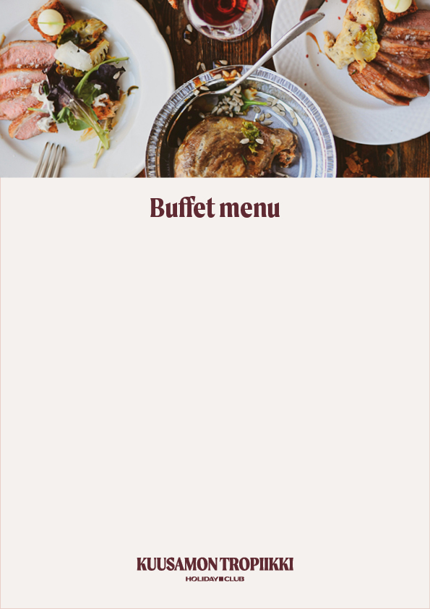
Monday Leek potato soup(L,G)
Wild game meatballs in pepper sauce (L)
Crispy fish fillet and tartar sauce (L)
Potatoes (L,G)
Roasted vegetables (M,G)
Coffee cake and éclairs (L)
Tuesday Paprika soup (L,G)
Beef neck in horseradish sauce (L,G)
Breaded chicken breast fillet
with sweet chili sauce (L)
Potato gratin (L,G)
Lentil-bean-kale roast (M,G)
Pancakes and strawberry jam
Wednesday Onion soup (M,G) Pork tenderloin in mushroom sauce (L,G) Fish patties with sour cream sauce (L,G) Potatoes (L,G)
Chickpea broccoli fry (M,G) Chocolate cake and Swiss roll
Thursday Tomato soup (M,G) Chicken roast cutlet with
jalopeno-mango glaze (L,G) Chop steak with onion sauce (L,G) Potato gratin (L,G) Mushroom-onion-pepper fry (L,G) Chocolate mousse and biscuits
Friday Forest mushroom soup (L,G) Beef neck in red wine sauce (L,G) Crispy fish fillet with dill sour cream (L) Potato rösti (L,G) Dragoon carrots (M,G) Passion cake and biscuits (L)
Saturday Beetroot soup (L,G Smoked pork cassler and bbq sauce (L,G) Chicken in ginger sauce (L,G) Jasmine rice (M,G) Chickpea broccoli fry (M,G) Chocolate hazelnut bun and biscuit
Sunday Sweet potato soup (L,G) Breaded chicken cutlets (L,G) Baked salmon (M,G) Potato wedges (M,G) Lentil-bean-kale roast (L,G) Waffle and brownie
32€ / Adults
16€ / Children 4-14 years, under 4y free
Members -10%
Restaurant Mango
Every day starting at 17p.m.
L/Lactose-free M/Milk-free G/Gluten-free

